Slide 1
Delta Tables

Slide 2
Delta Lake
Delta Lake : Delta Lake is the optimized storage layer that provides the foundation for storing data and tables in the Databricks Lakehouse Platform.
Delta Lake is the default storage format for all operations on Azure Databricks.
Delta Lake is the default format for all tables created with Databricks.
Delta lake is a data format based on Apache parquet. It provides ACID transactions, scalable metadata handling and unifies the streaming and batch data processing.

Slide 3
Delta Table
Databricks Delta Table records version changes or modifications in a feature class of table in Delta Lake.
Unlike traditional tables that store data in a row and column format, the Databricks Delta Table facilitates ACID transactions and time travel features to store metadata information for quicker Data Ingestion.
Data stored in a Databricks Delta Table is a secure Parquet file format.

Slide 4
ACID
ACID transactions guarantee that each read, write, or modification of a table has the following properties:
Atomicity - each statement in a transaction (to read, write, update or delete data) is treated as a single unit.
This property prevents data loss and corruption from occurring it.
Consistency - ensures that transactions only make changes to tables in predefined, predictable ways. Transactional consistency ensures that corruption or errors in your data do not create unintended consequences for the integrity of your table.

Slide 5
Isolation - when multiple users are reading and writing from the same table all at once, isolation of their transactions ensures that the concurrent transactions don't interfere with or affect one another. Each request can occur as though they were occurring one by one, even though they're occurring simultaneously.
Durability - ensures that changes to your data made by successfully executed transactions will be saved, even in the event of system failure.

Slide 6
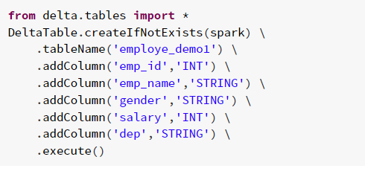
Create Delta Table
A `CREATE TABLE` statement
A table name (below we use `employe_demo`)
A schema
NOTE: In Databricks Runtime 8.0 and above, Delta Lake is the default format, and you don’t need `USING DELTA`.

Slide 7
Delta Table Instance
Delta table instance is to make soft link (replica) not actual table.
It is useful to perform DML(Data manipulation language) operations using PySpark Language.
Syntax:
Using Path DeltaTable.forPath(spark,”/path/to/table”)
Using Table Name DeltaTable.forName(spark,”table_name”)

Slide 8
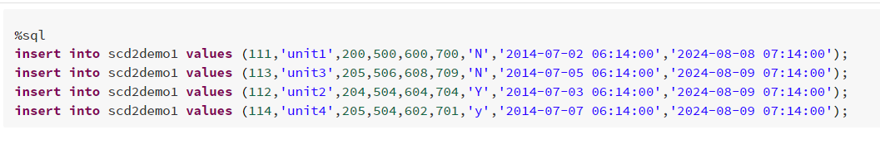
Insert the data
Insert data into Table

Slide 9

Delete command
Truncate It will remove only data in the Table.
Drop It will delete the entire data.
Delete It will delete the records (rows) based on condition (where command).

Slide 10

Update command
Update the records based on condition.

Slide 11
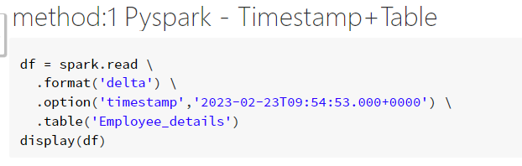
Time Travel
Delta Lake uses transaction logging to store the history of changes on your data.
with this feature, you can access the historical version of data that is changing over time and helps to go back in time travel on the delta table.

Slide 12
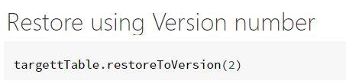
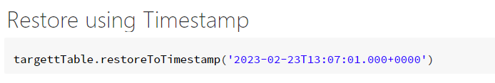
Restore command
Restoring to an earlier version number or a timestamp is supported.

Slide 13
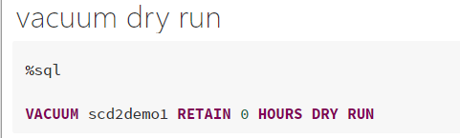
Vacuum command
Vacuum removes all files from the table directory that are not managed by Delta.
It will skip all directories that begin with an understand( _ ), which includes the _delta_log.

Slide 14
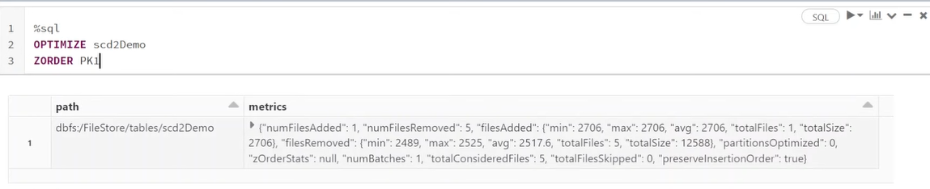
Z-order command
Optimize command – The optimize command reclaims unused space, reorganizes data, and updates metadata statistics to improve query performance. In other words, it unites the smaller files into one file . Its default size is 1GB.
Z-order – It is used along with optimize command to organise the data.
Syntax: optimize table_name zorder column_name

Slide 15

presented by
Niranjan Naidu Setha

